Slide 1
UNDERSTAND THE SUPPORT OPTIONS AVAILABLE IN AZURE

Slide 2
Agenda
Support Plans
How to open a support case
Available support channels outside of support plans
Knowledge Center

Slide 3
Support Plans
Before we get into the details of each plan, there are a few terms you should be familiar with related to Azure support.
Business hours Microsoft defines business hours for most countries as weekdays from 9:00 AM to 5:00 PM local time. However, in North America, business hours are weekdays from 6:00 AM to 6:00 PM Pacific time, and in Japan, business hours are weekdays from 9:00 AM to 5:30 PM. In all regions, business hours do not include holidays.
Severity A case Microsoft uses Severity A to refer to a production application that is entirely down, or when a critical component of a production app is unavailable.
Severity B case Microsoft uses Severity B to refer to a production application that is moderately impacted. This severity level is subjective and agreed to by Microsoft support and the customer.
Severity C case Microsoft uses Severity C to refer to a situation that is causing minimal impact. These are cases that refer to problems no longer happening or cases that aren’t impacting a production application.

Slide 4
Support Plans
Microsoft offers the following support plans for Azure.
Basic Limited support that’s free for all Azure subscriptions.
Developer Azure support for free trial and non-production applications.
Standard Azure support for production applications.
Professional Direct Azure support for business-critical applications.
Premier Contracted support for all Microsoft products, including Azure.
All support plans offer 24x7 support for any billing issues or subscription issues, access to Azure Advisor recommendations, the Service Health Dashboard, and the Health API. All paid support plans offer access to Microsoft support engineers.
You can change your support plan or cancel your support plan via the Azure portal. If you cancel a support plan partway through the month, you are not refunded for the prorated amount.

Slide 5
Support Plans
 | Developer | Standard | Pro Direct | Premier
Price | $29 per month | $100 per month | $1,000 per month | Contract price varies
Tech Support | Access to support engineers via email only during business hours. | Access to support engineers 24x7 via email or phone. | Access to support engineers 24x7 via email or phone. | Access to support engineers 24x7 via email or phone.
Severity Available | Severity C only. | All severity levels. | All severity levels. | All severity levels.
Response Time | Fewer than 8 business hours. | Sev C: Fewer than 8 business hours. Sev B: Fewer than 4 business hours. Sev A: Under 1 business hour. | Sev C: Fewer than 4 business hours. Sev B: Fewer than 2 business hours. Sev A: Under 1 business hour. | Sev C: Fewer than 4 business hours. Sev B: Fewer than 2 business hours. Sev A: Under 1 business hour or under 15 minutes with the purchase of Azure Rapid Response or Azure Event Management.
Architecture Guidance | General only | General only | Guidance based on best practices. | Customized guidance that includes design reviews, performance tuning, configuration assistance, and so on.
Operations Support |  |  | Assistance with onboarding, service reviews, and Azure Advisor consultations. | Service reviews and reporting led by a technical account manager (TAM) assigned to your account.
Training |  |  | Web seminars conducted by Azure engineering teams. | Web seminars conducted by Azure engineering teams. On-demand training coordinated via TAM.
Proactive Guidance |  |  | Provided by delivery manage for Pro Direct. | Provided by TAM.
Launch Support |  |  |  | Available via Azure Event Management for an additional cost.

Slide 6
Agenda
Support Plans
How to open a support case
Available support channels outside of support plans
Knowledge Center

Slide 7
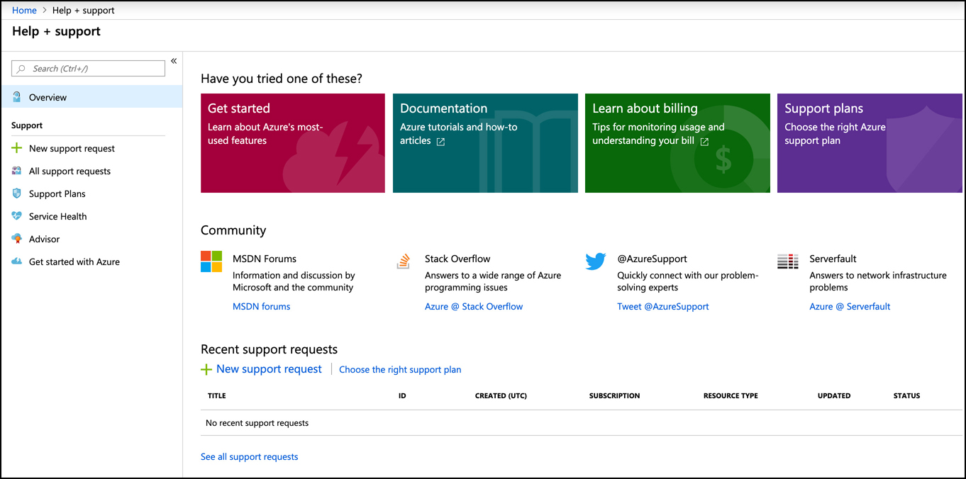
How to open a support case
Support cases can be created from the portal home page by clicking on Help + Support from the menu on the left side of the page.
You can also create a support case from within a particular Azure resource by opening the resource and clicking on New Support Request from the Support + Troubleshooting section of the menu on the left.
The self-help options included here are general in nature and include links to documentation and links to forums where you can ask for help from other Azure users. You can also tweet to @AzureSupport for quick assistance for simple issues.

Slide 8
How to open a support case
To create a support case to a Microsoft support engineer, click on New Support Request.
Select Yes to indicate you have an issue related to an Azure subscription. (The No option is for problems related to Azure Active Directory.)
Select the issue type. The issue type can be a billing issue, a subscription issue, a quota issue, or a technical issue. In this example, we’re using the Technical issue type.
Select the Azure service.
Select the resource you need help with. (Your choice will be restricted to the type of Azure service you selected.)
Select your problem type. Problem type options will differ depending on the service type.
Select the problem subtype. Problem subtype options will differ depending on the service type.
Enter a brief subject for your support case.
Click Next: Solutions to process to the next step.

Slide 9
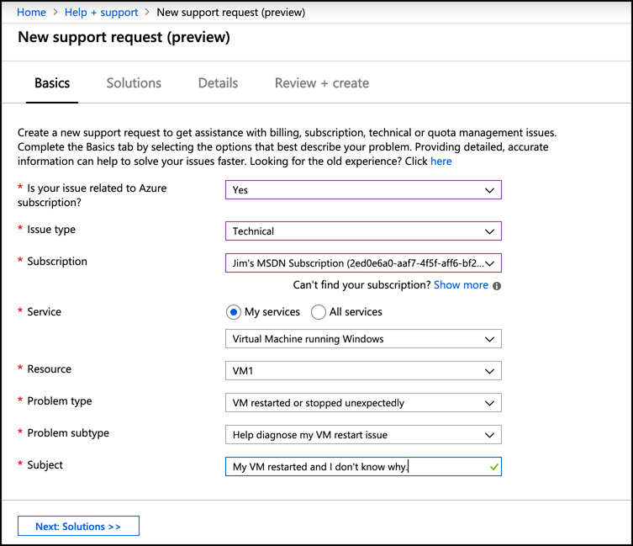
How to open a support case
Microsoft constantly analyzes historical customer issues so they can offer you possible solutions based on the information you provide when opening a case.
They use the problem type, the problem subtype, and the text you enter in the subject to determine what the problem might be.

Slide 10
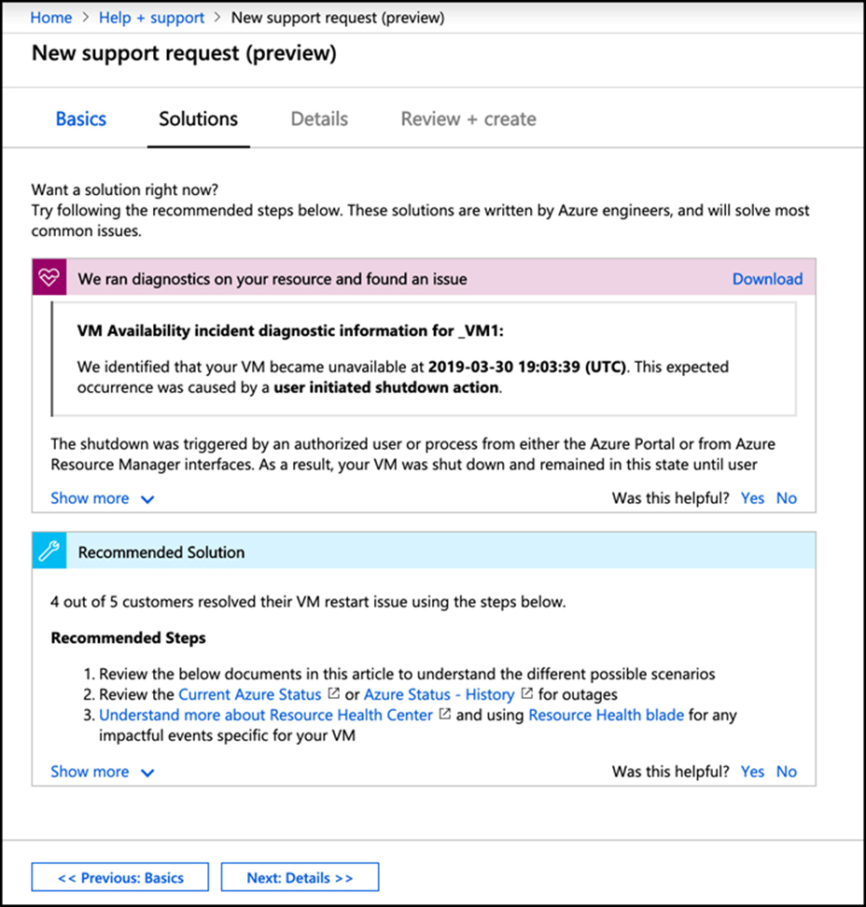
How to open a support case
You can see that Microsoft is suggesting that the restart might have been due to a user-initiated restart of the VM. If you decide that this didn’t cause the issue, click on Next: Details to move to the next step.

Slide 11
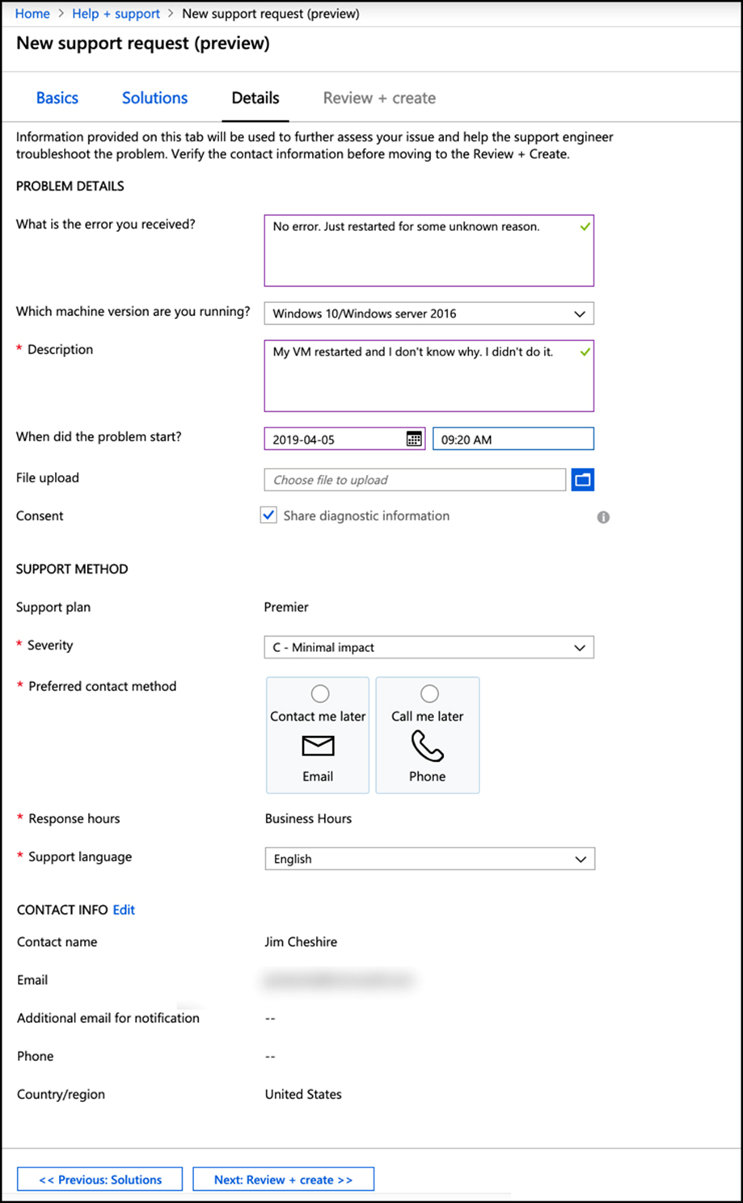
How to open a support case
The final step in creating a case is to enter the details for your issue. Some of these options will differ depending on the resource type. In this example, options are for an Azure VM.

Slide 12
Agenda
Support Plans
How to open a support case
Available support channels outside of support plans
Knowledge Center

Slide 13
Available support channels outside of support plans
If you don’t have an Azure support plan, you can still get help with Azure technical issues from forums or from Twitter, but you won’t have any support SLAs, and you won’t be able to talk directly to a Microsoft support engineer.
2 forum channels available for Azure issues.
MSDN forums Accessible at: https://aka.ms/MSDNForums. Search for your product to find the relevant forum.
Stack Overflow forums Accessible at: https://stackoverflow.com. Click on Tags and search for your Azure service.
MSDN and Stack Overflow forums are user-to-user forums where Azure customers can help each other. Microsoft also monitors the forums and can provide assistance with simple issues. However, in some cases, they will ask you to open a support case.
You can also tweet to @AzureSupport for assistance with simple issues. This is the official Microsoft Twitter account for helping you find answers to common questions and support for basic issues.

Slide 14
Agenda
Support Plans
How to open a support case
Available support channels outside of support plans
Knowledge Center

Slide 15
Knowledge Center
To assist you with finding documentation and blog posts on common issues, Microsoft developed the Knowledge Center. You can access the Knowledge Center by browsing to: https://azure.microsoft.com/en-ca/resources/knowledge-center

Slide 16
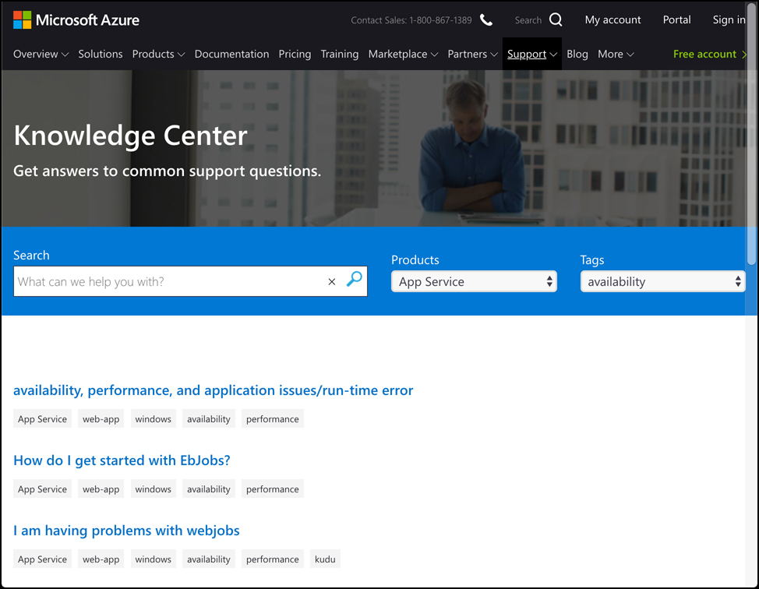
Knowledge Center
You can filter on the Azure product you’re interested in. Each product has a series of tags that you can use to further filter the links that you see in the Knowledge Center. You can also enter in a search term to find something more specific to your problem.

